Slide 1
Air Quality Index
Prediction
PREPARED BY ASMITA BASNET

Slide 2
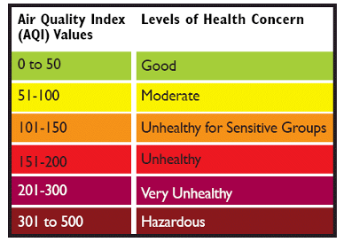
Introduction To Topic
The Air Quality Index (AQI) is a standardized numerical scale used to communicate the quality of air and its potential impact on human health. It simplifies complex data from multiple air pollutants—such as particulate matter (PM2.5, PM10), nitrogen dioxide (NO2), sulfur dioxide (SO2), carbon monoxide (CO), and ozone (O3)—into a single value that indicates the level of air pollution. AQI values are typically categorized into ranges that correspond to different health advisories, such as "Good," "Moderate," or "Hazardous," making it easier for the public to understand air quality conditions and take necessary precautions.By providing real-time updates, the AQI enables individuals, governments, and organizations to make informed decisions about outdoor activities, health precautions, and policies to mitigate air pollution’s effects. It is a crucial indicator for understanding air pollution trends and promoting environmental and public health awareness.

Slide 3
INTRODUCTION
01
Role of AI in AQI Prediction
TO CONCEPTS OF AQI
AI enhances AQI prediction by using advanced models to analyze pollution levels and environmental factors, ensuring accurate and reliable forecasts. Hybrid AI approaches outperform single models and handle complex interactions like temperature, wind, and pollution sources. This makes AI a powerful tool for improving air quality predictions.
03
Related Domains
AQI prediction using regression analyzes pollutants like PM2.5 and CO, alongside factors, to forecast continuous AQI values. Regression models learn patterns from historical data, identifying key factors that influence air quality. This approach ensures accurate and reliable AQI predictions for effective monitoring and interventions.
02
Necessity of AI for AQI Prediction
AI is crucial for AQI prediction, as it overcomes the limitations of traditional methods in handling complex, dynamic air quality data. It identifies patterns in large datasets, like meteorology and pollutant data, to deliver accurate and stable predictions. This makes AI vital for real-time monitoring and supporting public policies.

Slide 4

Aims and Objective
The research aims to formulate robust and accurate AI prediction models of the air quality index (AQI) to provide timely and actionable information regarding air quality for public health protection and environmental policy formulation.
Objective 01
Objective 02
Objective 03
Identifying Key Factors:
Determine the key pollutants and meteorological factors influencing AQI, essential for accurate prediction.
Real-Time Forecasting and Societal Impact:
Develop models for near real-time forecasting to support proactive decision-making and address gaps in AQI prediction, enhancing its societal value.
Implementing AI Techniques: Explore and apply advanced AI methods, like machine learning, to improve AQI prediction and compare their performance with traditional models.

Slide 5


SOLUTION
To address the AQI prediction challenges, this system integrates advanced artificial intelligence (AI) techniques, specifically machine learning models, to forecast AQI levels more accurately. By identifying key pollutants and meteorological factors that influence air quality, the AI models provide more reliable predictions compared to traditional statistical approaches. The system uses regression models and AI-driven algorithms to handle the complexities of non-linear interactions among various environmental factors. This solution aims to offer near real-time forecasting, enhancing decision-making capabilities for governments and communities to mitigate the adverse effects of air pollution and improve public health outcomes.
PROBLEM DOMAIN
The problem domain focuses on the challenges of accurately predicting the Air Quality Index (AQI) to mitigate the health risks posed by air pollution. Pollutants like PM2.5, CO, NO2, and SO2, combined with fluctuating weather conditions, contribute to the complexity of AQI forecasting. The non-linear, dynamic nature of air quality data makes it difficult for traditional methods to produce reliable results. Inaccurate or missing data further complicates the prediction, especially with local environmental factors such as industrial activities, urbanization, and traffic patterns. Thus, accurate AQI predictions are critical for public health, environmental policy-making, and timely interventions.

Slide 6




Literature Review
Previous Research
Dataset Analysis
Model Evaluation
Air quality prediction has evolved from classical models to machine learning techniques, incorporating meteorological variables like temperature, wind speed, and humidity. Random Forest has consistently shown strong performance due to its ability to handle noisy and non-linear data. Feature selection and data preprocessing have been critical in improving prediction accuracy. Despite advancements, challenges such as data complexity and scalability remain in forecasting AQI reliably across regions
The city_day.csv dataset contains over 20,000 records with pollutants like PM2.5, CO, NO2, and SO2, along with meteorological data, making it ideal for AQI prediction. It aligns with the EPA’s air quality standards and includes key environmental factors. The dataset was chosen over others due to its comprehensive features, essential for accurate AQI forecasting. After addressing missing values and redundancies, the dataset was cleaned and prepared for model training.
Key evaluation metrics include RMSE, MSE, and MAE, highlighting the importance of preprocessing techniques. The models’ ability to handle complex relationships between pollutants and meteorological factors is crucial for accurate predictions. The evaluation emphasizes the need for model optimization and fine-tuning to improve performance.

Slide 7
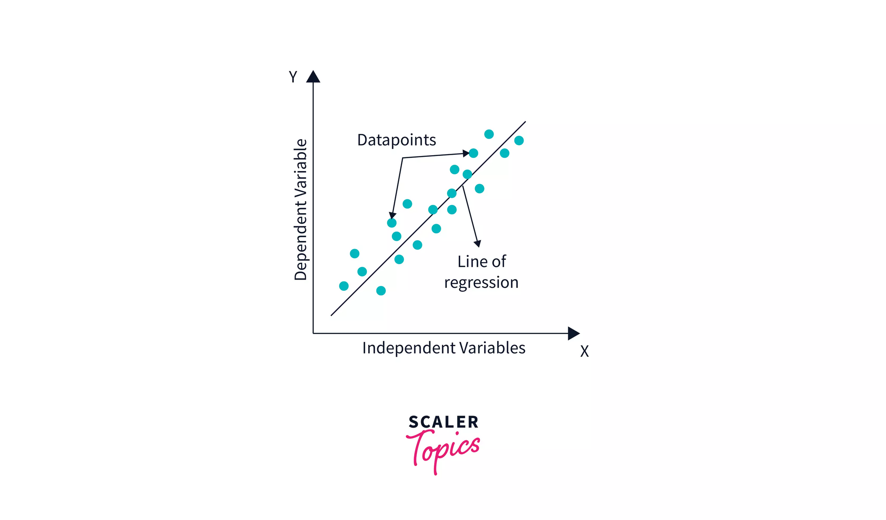
ALGORITHM USED
LINEAR REGRESSION
Linear regression is a fundamental algorithm that models the relationship between independent variables (predictors) and a dependent variable (outcome) using a linear equation. It predicts continuous values by estimating the best-fit line that minimizes the difference between the observed and predicted values. Known for its simplicity and interpretability, it is particularly effective for problems with a linear relationship between variables. Evaluation metrics such as R-squared and Mean Squared Error (MSE) are commonly used to measure its performance.

Slide 8
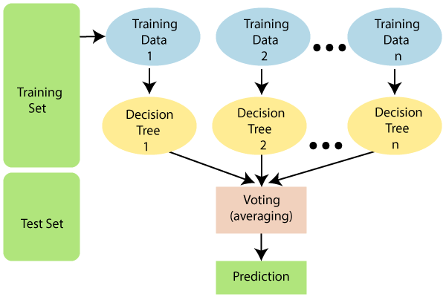
ALGORITHM USED
RANDOM FOREST
Random Forest is an ensemble learning method that constructs multiple decision trees and aggregates their predictions to improve accuracy and reduce overfitting. It handles non-linear relationships and complex datasets effectively, making it suitable for diverse regression tasks. By averaging predictions from individual trees, it enhances robustness and generalization. Hyperparameters, such as the number of trees and tree depth, can be tuned to optimize performance.

Slide 9
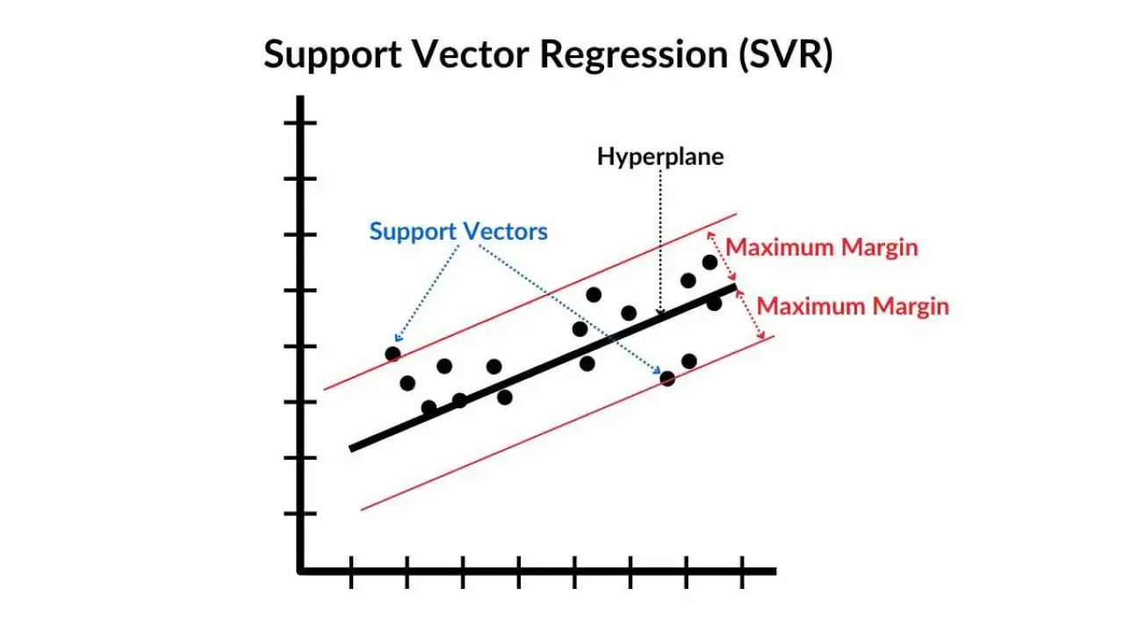
ALGORITHM USED
SVR
Support Vector Regression is a powerful extension of Support Vector Machines, designed for regression tasks. It maps input features to a higher-dimensional space using kernels, allowing for both linear and non-linear regression. SVR optimizes a hyperplane that minimizes error within a defined margin, making it robust to outliers and overfitting. Key parameters like regularization and kernel functions are tuned to achieve optimal results. The model’s performance is assessed using MSE and R-squared, highlighting its flexibility and precision in handling various regression problems

Slide 10
SOlUTION APPROACH
The process begins with collecting relevant data from reliable sources to ensure it contains the necessary features and enough instances for meaningful analysis.
Linear Regression, Random Forest Regression and SVR are selected for their strengths in handling both linear and complex, non-linear relationships.
Data Collection
3. Model Selection
2. Data Preprocessing
4. Model Training and Evaulation
Data preprocessing involves cleaning and preparing the dataset by handling missing values, outliers, and encoding categorical variables
The models are trained on the preprocessed dataset to learn patterns and relationships. Their performance is evaluated using metrics like R-squared and Mean Squared Error (MSE) to ensure accuracy and reliability.

Slide 11


DATA PRE PROCEESING
Data Cleaning
Result
Data cleaning involves removing inconsistencies, handling missing values, and addressing outliers to ensure the dataset is accurate and reliable. This step reduces noise and errors, enabling the model to focus on meaningful patterns.
Preprocessing transforms the cleaned dataset into a suitable format for machine learning by encoding categorical variables, normalizing numerical data, and splitting it into training and testing sets. This ensures compatibility with algorithms and improves model performance.

Slide 12
Model Evaluation: Performance Metrics and Comparison
MSE
RMSE
Measures the average squared difference between predicted and actual values.
Represents the square root of the MSE, providing a more interpretable measure of error.
MAE
R-SQUARED
Calculates the average absolute difference between
predicted and actual values.
Indicates the proportion of variance in the target variable explained by the model.

Slide 13
Model Evaluation Scores
SUMMARY FOR THE EVALUATION SCORE
Random Forest was the most accurate model, achieving the highest R-squared value (0.8476), indicating its superior ability to capture complex relationships.
Random Forest had the lowest error rates, while Linear Regression showed the highest, highlighting its limitation in handling non-linear patterns. SVR performed moderately with balanced error metrics.
Advanced models like Random Forest and SVR outperformed Linear Regression due to their capability to model intricate dependencies and non-linear patterns in the data.
MODEL | Linear Regression | Random Forest Regressor | SVR
R^2 SCORE | 0.525 | 0.847 | 0.716
MAE | 52.365 | 22.870 | 31.720
MSE | 7298.86 | 2346.252 | 4371.101
RMSE | 85.433 | 48.438 | 66.114

Slide 14
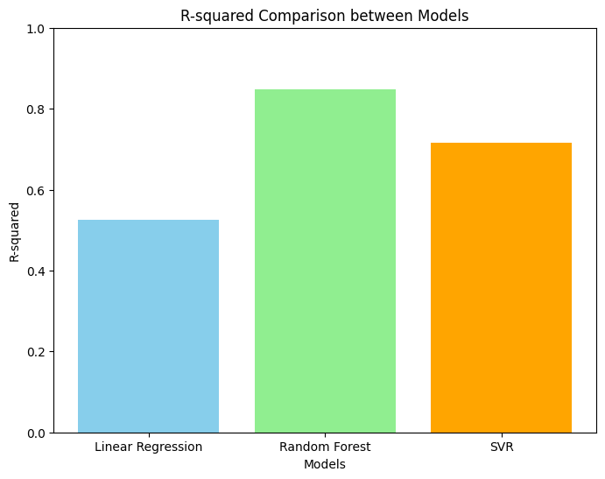
KEY TAKEAWAY
Model Selection:
Advanced models like Random Forest and SVR demonstrated significantly better performance than Linear Regression, highlighting the importance of choosing the right algorithm for datasets with non-linear and complex relationships
Data Preprocessing
Effective handling of missing values, outliers, and appropriate feature extraction played a vital role in improving the performance and reliability of all models.
Balancing Accuracy and Complexity
While Random Forest provided the best accuracy, it comes at a higher computational cost. SVR balanced accuracy and complexity well, making it a viable option for non-linear problems.

Slide 15

APPLICATION AND IMPACT
Air Quality Monitoring
The models developed in this project provide accurate predictions of air quality, enabling real-time monitoring and timely alerts. This can help individuals and organizations take necessary actions to reduce health risks associated with poor air quality.
Policy Making
The insights from the prediction models can guide policymakers in identifying pollution trends and designing targeted interventions. This ensures more effective environmental regulations and long-term solutions to combat air pollution.
Public Awareness
By providing easily accessible and accurate AQI information, this system empowers individuals to make informed decisions, such as planning outdoor activities during safe periods, thereby reducing exposure to harmful pollutants.
With a global perspective, our marketing agency has proudly served multinational clients, delivering tailored strategies that transcend borders and cultures, ensuring consistent brand success on a worldwide scale.

Slide 16
Future Goals for This Project
Advanced Model Exploration
Real-Time Deployment
Feature and Hyperparameter Optimization
Explore additional regression techniques, such as Gradient Boosting, XGBoost, or neural networks, to improve prediction accuracy and handle more complex data patterns.
Develop dynamic pipelines for real-time predictions and integrate the models into web or mobile platforms to enable practical, on-the-go decision-making.
Focus on advanced feature engineering to enhance model input and implement automated hyperparameter tuning techniques to further refine model performance.

